Slide 1
SteamVox
Steam Reviews: Topic Modelling And
Sentiment Analysis
Capstone Project by Alfred Tang
Data Science Immersive 8
General Assembly
August 2019

Slide 2

SteamVox in a nutshell
Steam
Online PC game app store
Vox
“Voice” in Latin
Voice of the customer
Image source: Valve Corp
https://store.steampowered.com/

Slide 3
What is Steam?
Biggest online distributor for PC games
Huge market share
18% of all PC game sales globally (US$4.3 billion, 2017)*
Image source: Valve Corp
https://store.steampowered.com/

Slide 4
SteamVox in a nutshell
Current state
v0.1: Total War: Three Kingdoms only
Future plans
Make applicable across most games on Steam

Slide 5
Who Can Benefit From This Project?
Game Developers
Game Publishers
Market Data Companies
Writers for Entertainment Publications

Slide 6
Why does SteamVox Matter?

Slide 7
The Problem(S)
Game developers always pressed for time
Game publication is time-sensitive
Reading reviews is time-consuming

Slide 8
Common (Timeless) Game Design Problems
Unrealistic scope: 75%
Feature creep: 75%
Cutting features: 70%
Design problems: 65%
Delays: 65%
Technological problems: 60%
These problems plague both developers and players!
Resources are limited
Prioritisation is key
Source:
“What went wrong? A survey of problems in game development”
(Petrillo, F. et al, 2009)

Slide 9












VIDEO GAMES: A TOUGH BUSINESS
Game publication and sales are time-sensitive
@#%*!
Time

Slide 10
Real-World Example: Online Game Publication
New content released
Managers want player sentiment on new content
Executives talk to veterans and/or trawl forums manually
Veterans cannot represent whole player base
Not practical to read 10,000 forum posts
“Best guess” from brief skim of news, forums & social media
Cannot confidently ascertain player sentiment
Recommended actions may not be what players want
1 per min → 20.83
working days! (assuming 0 failures)

Slide 11
Problem Statement
Are the features of my game well-received?
How do I obtain supporting data ASAP?
Any urgent issues to fix?
What data supports this conclusion?
Which features in particular?

Slide 12
How does SteamVox help?

Slide 13












Steamvox: An Overview
Get insights
Make sequel
Happy players spend money
Improve
features
PROFIT!
Scrape
reviews
Filter,
tokenise,
clean
Topic
Modelling
(LDA)
Assess
modelled
topics
Assign
topics
Score
sentiment
Notes:
Scrapes reviews from Steam
Filters and cleans reviews to reduce noise
Identifies topics of discussion
Assigns sentiment scores per topic in each review
Aggregates scores by topic whole dataset
Outputs a snapshot

Slide 14
What differentiates SteamVox?
No similar tool available on Steam or SteamSpy (Yet)

Slide 15
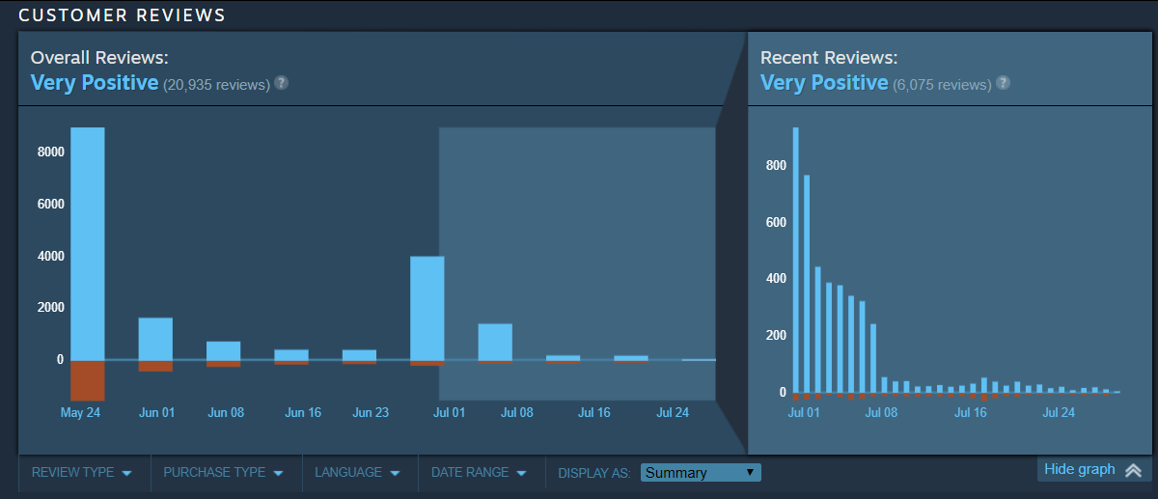
Steam Reviews
Review ratings over time for
Total War: Three Kingdoms
Graph provides overall sentiment
Granular details, e.g. sentiment on specific features not available

Slide 16
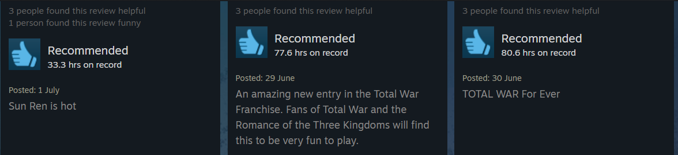
Steam Reviews
Similar to social media posts
Mostly short reviews with general comments
Spam is common, especially for Free-to-Play games

Slide 17
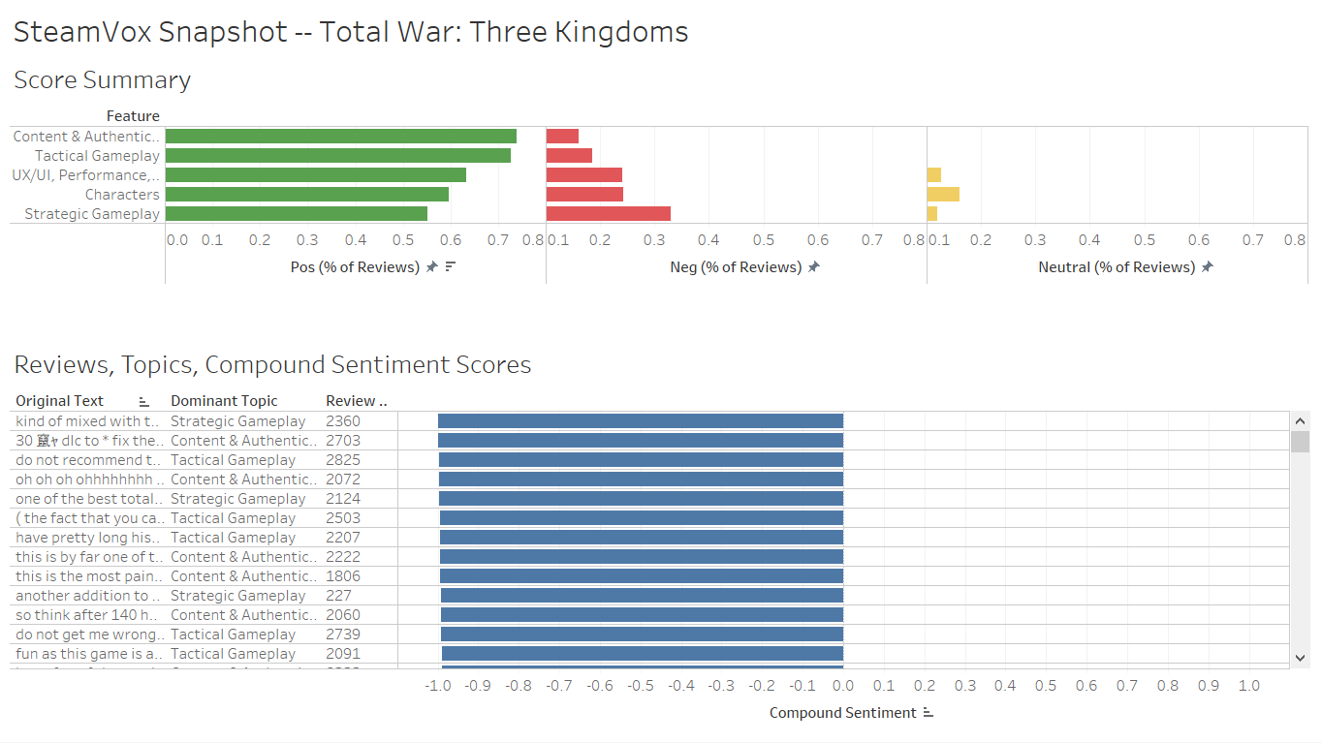
SteamVox on Tableau

Slide 18
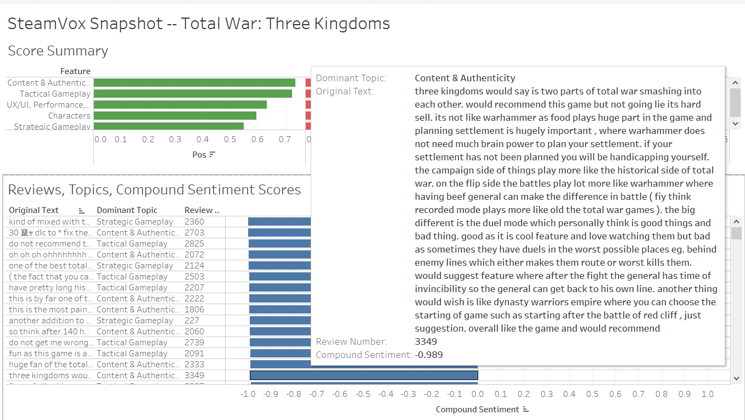
SteamVox on Tableau

Slide 19
SteamVox v0.1 Dataset
Steam API
Review Counts
8,235 English Steam reviews
8,150 unique reviews
3,661 determined usable
> 100,000 words

Slide 20
SteamVox Anatomy
Scrape Steam Reviews
Filter, Clean, Tokenise
Identify topics (using topic model)
Sentiment Analysis
Generate snapshots

Slide 21
SteamVox Anatomy
Scraping
steamreviews, a Python package by woctezuma
Cleaning and Tokenisation
NLTK, SpaCy, genism, Syntok
Topic Modelling
Latent Dirichlet Allocation, genism, ldaMulticore
Sentiment Analysis
VADER SentimentIntensityAnalyzer
Generate snapshots

Slide 22
1. Scraping
steamreviews package
pip install steamreviews
Get appID from Steam Store
Call scraping function, input appID
steamreviews queries Steam API

Slide 23
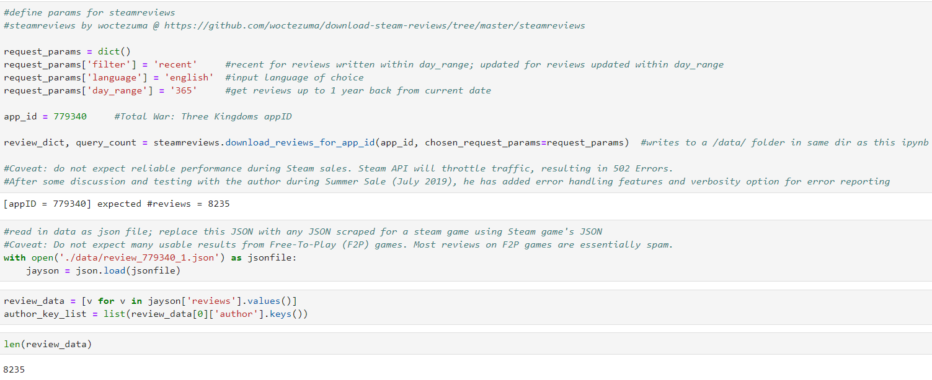
1. Scraping

Slide 24
2. FILTER, CLEAN, TOKENISE
Objectives:
Get meaty, coherent reviews
Clean reviews so LDA Model can process them

Slide 25
2. Clean & TokeniSE
CLEAN, Tokenised Text
Original text
As a Chinese player and a fan of Three Kingdoms, I've never thought that a foreign company can make such a fantastic Three Kingdoms game. The Creative Assembly did its best to make the game immersive and close to the history. So shut up and take my money.
['chinese', 'player', 'fan', 'three', 'kingdoms', 'thought', 'foreign', 'company', 'fantastic', 'three', 'kingdoms', 'creative', 'assembly', 'best', 'immersive', 'close', 'history', 'shut', 'money']

Slide 26
2. Cleaning and Tokenisation
This will make or break the topic model!
Cleaning will be revisited many times as the topic model is improved
Choice of tokenisation tools also matters
Most popular package not always the right tool

Slide 27
2. FILTER
Steps:
Filter reviews by conditions
Tokenise reviews into lists of important terms
Identify phrases (n-grams)
Lemmatise each token and retain only nouns

Slide 28
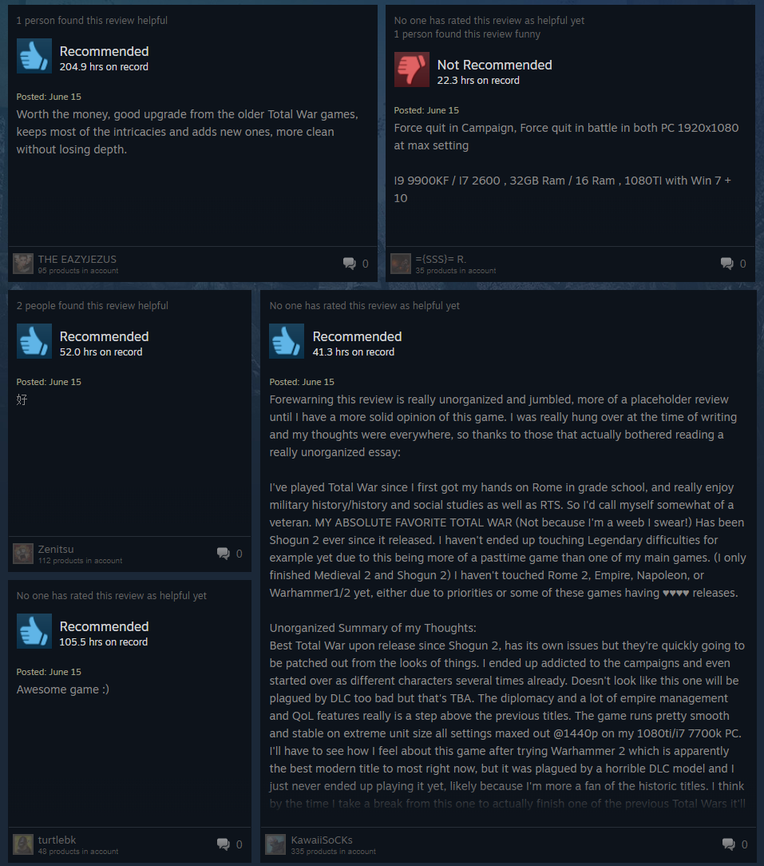


FILTER REVIEWS

Slide 29
2. FILTERING CONDITIONS
Review Attribute | Condition
Player Playtime (when written) | Total >= 3 hours Recent playtime >=10 min
Review Length | >= 5 words
Review uniqueness | Duplicates from same user NOT allowed
Language | EN only

Slide 30
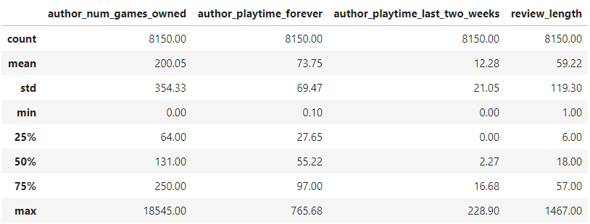
2. Cleaning and Tokenisation
1. Filtering reviews
Raw data
Unusable!

Slide 31
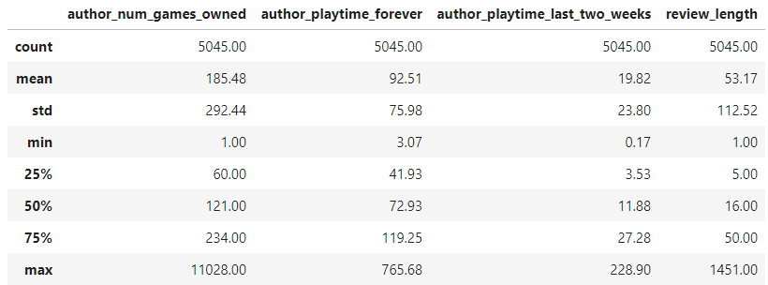
2. Cleaning and Tokenisation
1st filtering:
Min playtime >= 3h ; Min playtime last 2 weeks >= 10 min
Steam allows refunds for up to 2h playtime; opinions are more valid with recent gameplay
3015 reviews dropped
Still unusable!
Set cut-off here

Slide 32
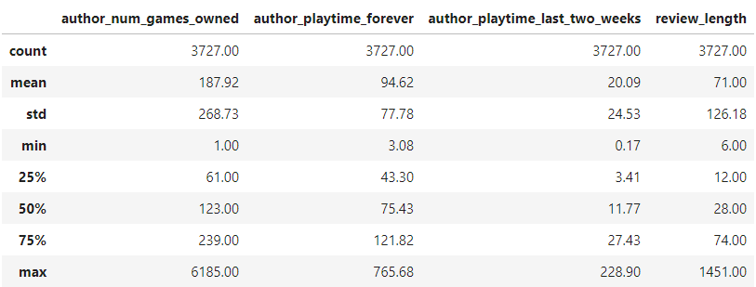
2. Cleaning and Tokenisation
2nd filtering: Review lengths >= 5 words
Minimum review qualification: “Best Total War game ever”
3727 reviews remain
Now usable

Slide 33
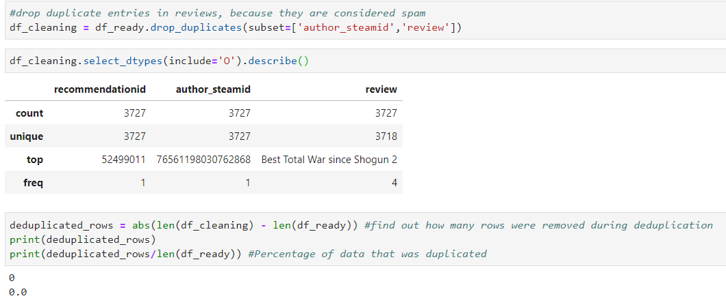
2. Cleaning and Tokenisation
3rd filtering: Remove duplicates
No reviews dropped. 4 of the same review appeared, written by 4 different users.

Slide 34
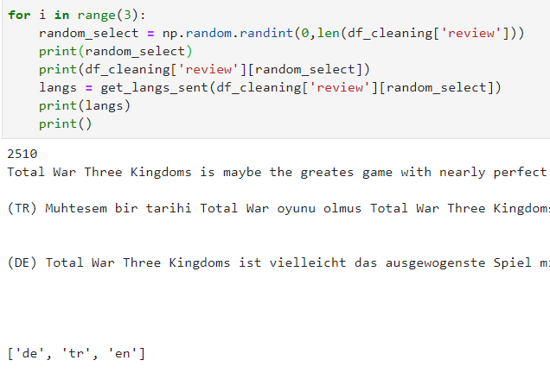
2. Cleaning and Tokenisation
4th filtering: Languages (using SpaCy langdetect)
Logic: Model is built to analyse English.
Also, Steam reviews classified as EN still contain text from other languages.
Contains 3 languages.

Slide 35
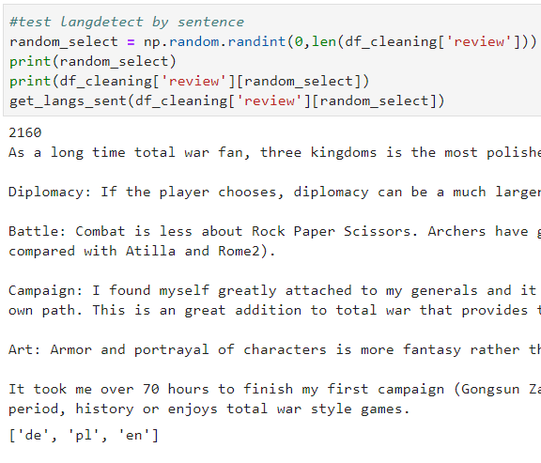
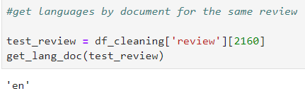
2. Cleaning and Tokenisation
4th filtering: Languages (Flaws in SpaCy langdetect)
False positives will be detected in some reviews
Far more false positives are detected when identifying languages by sentence
Risk dropping too many reviews going by sentence
Notes:
Language detection is scored by probability. Language of a document is more reliable because it returns a dict or lists of average probability scores across the whole document, then selects the highest-probability language.

Slide 36
2. Cleaning and Tokenisation
4th filtering: Languages (Final decision)
Drop multilingual reviews including false positives
Final dataset will be mostly clean
False negatives that make it through can be filtered away later
Reduce number of multilingual reviews
Multilingual terms become rare enough to filter out

Slide 37
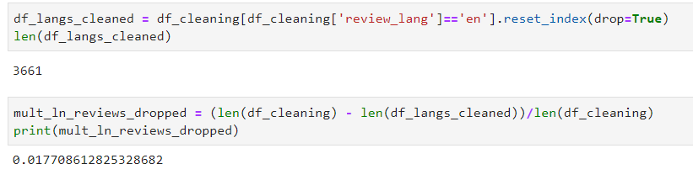
2. Cleaning and Tokenisation
Ready for pre-processing

Slide 38
2. Clean and TokenisE
What is cleaned? | What is it? | Before | After
BBCode | Markup language used by Steam | [B]I love this game![/B] | I love this game!
Contractions | Informal shorthand | Can’t, won’t, ain’t | Cannot, will not, is not
Punctuation | Anything not alphanumerical | Very gud game. Is balans ))))))))))))) | Very gud game is balans
Numerals (to Words) | Arabic & Roman numerals | Shogun 2 | Shogun Two
Spam words | Unwanted, incoherent words | REEEEEEEEEEEEEEEEEEEEEEEEEEEEEEEEEEEEEEEEEEEEEEEEEEEEEEEEEEEEEEEEEEEEEEEEE LU BU OP | LU BU OP

Slide 39
2. Cleaning and Tokenisation
2. Cleaning
Remove BBCode
Steam uses Bulletin Board markup language
Expand contractions
can’t → cannot
Easier to remove common, uninformative words

Slide 40
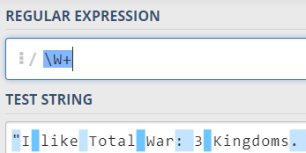
2. Cleaning and Tokenisation
2. Cleaning
Remove punctuation
Regex split on non-word character
Convert digits & Roman numerals up to 3 into words
Often form part of important phrases
game names in a series, e.g. Shogun 2, Warhammer II

Slide 41
2. Cleaning and Tokenisation
2. Cleaning
Retain only words >1 char and <= 45
Single-character words not helpful, e.g. “a”
longest word in EN: pneumonoultramicroscopicsilicovolcanoconiosis
Spam reviews include incoherent words
“REEEEEEEEEEEEEEEEEEEEEEEEEEEEEEEEEEEEEEEEEEEEEEE LU BU OP”

Slide 42
2. Cleaning and Tokenisation
3. Identify phrases (n-grams)
Tokens that frequently occur together form phrases
best
total
war
best_total_war

Slide 43
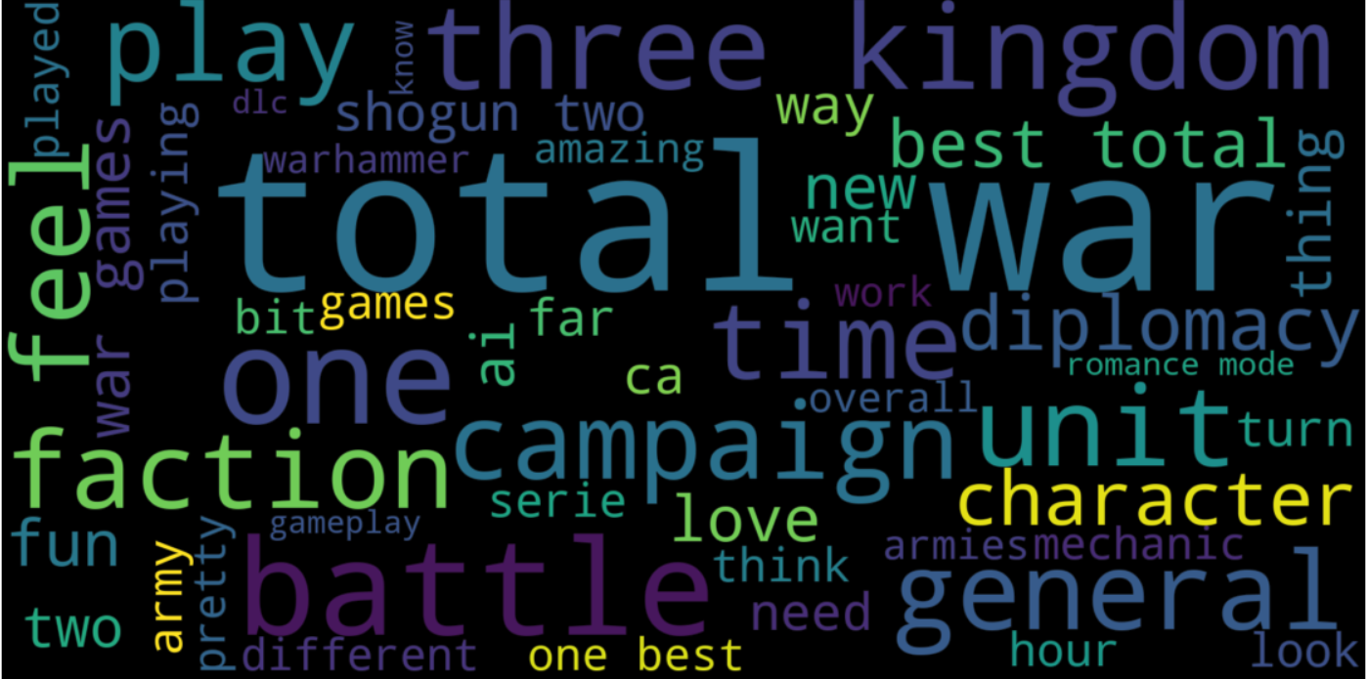
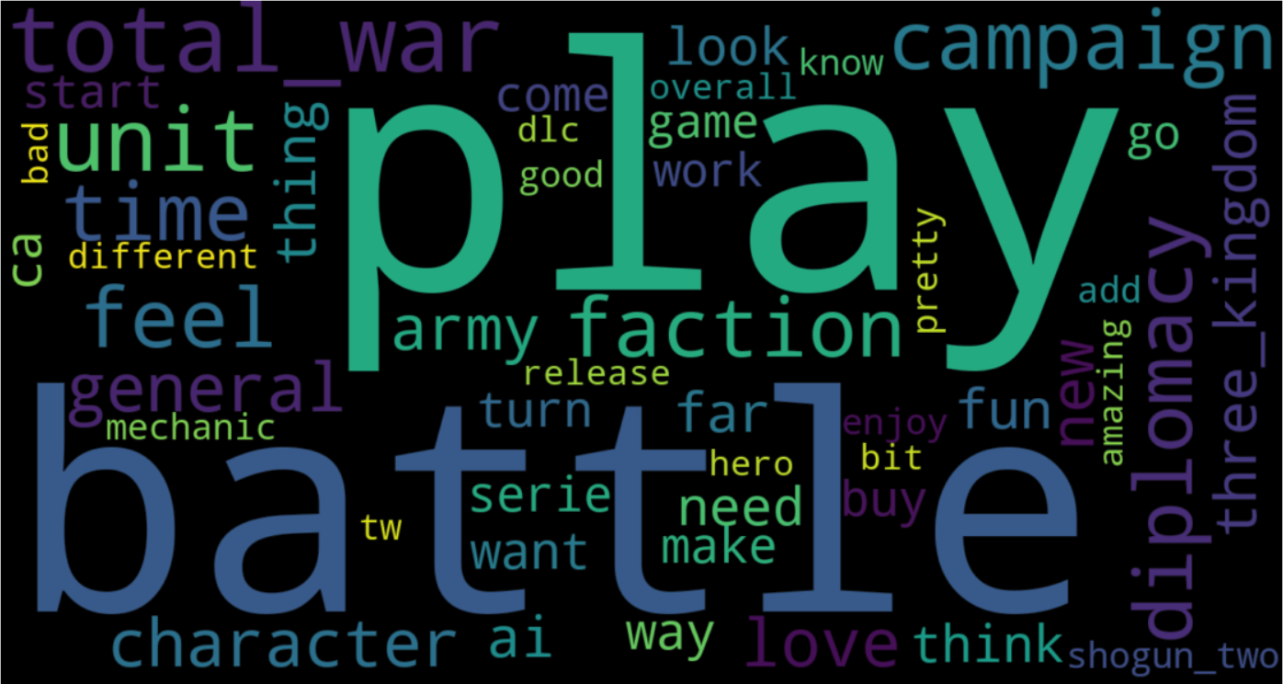
2. Cleaning and Tokenisation
3. n-grams increase coherence
1-grams only
n-grams included

Slide 44
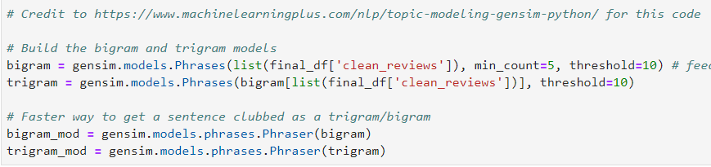
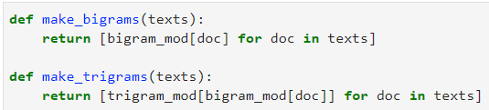
2. Cleaning and Tokenisation
3. Identify phrases (n-grams)
To create 3-grams, just make 2-grams twice
Sorcery!

Slide 45
2. Cleaning and Tokenisation
Sorcery in action
best
total
war
3 tokens
best
total_war
2 tokens
best_total_war
1 token

Slide 46
2. Cleaning and Tokenisation
4. Lemmatisation
Reduce inflected words to common dictionary form
Word | Lemma
Playing | Play
Plays | Play
Played | Play
3 counts of ‘Play’

Slide 47
2. Cleaning and Tokenisation
4. Lemmatisation (Cleaning)
Retain only phrases and nouns
Word | Class | Drop? | Lemma
playing | Verb | Drop
exciting_battles | Noun (even if 2 non-nouns) |  | exciting_battles
exciting | Adjective | Drop
battles | Noun |  | battle
cao_cao | Noun |  | cao_cao

Slide 48
2. Cleaning and Tokenisation
4. Lemmatisation
Game features are nouns
Identify features using objects and subjects (i.e. nouns)
Phrases are also helpful
E.g. Character names, “cao_cao”, “lu_bu”
Filter by Part-Of-Speech tags → nouns only

Slide 49
2. Cleaning and Tokenisation
4. Lemmatisation (Cleaning)
After making n-grams, unqualified parts remain
e.g. “three” by itself after making “three_kingdoms”
“three” by itself likely to have no meaning
Remove such words after n-grams and lemmatisation

Slide 50

3. Topic Modelling
Latent
Dirichlet Allocation
Hidden
Probability Distribution

Slide 51



3. How LDA WORKS
Category:
Missing category!
Read Text
Identify Category
Identify keywords

Slide 52



3. Topic Modelling
Step 1: Define N topics
“I think there could be 10 topics…”
Can be trial and error
Can base on domain knowledge
Pass to the model as input

Slide 53


3. Topic Modelling
Step 2: Temporary Topic Assignment (Auto)
Review 1
trade
diplomacy
proxy_war
faction
proxy_war
Review 1 | Temp Topic
trade | 0
diplomacy | 3
proxy_war | 3
faction | 2
proxy_war | 1
Model assigns temporary topic
(semi-random)
One document
For all documents
Bag of words
Words and topics

Slide 54

3. Topic Modelling
Step 3: Update topics (iterative, auto)
Prevalence of…
Review 1 | Temp Topic
trade | 0
diplomacy | 3
proxy_war | 0
faction | 2
proxy_war | 0
Review 1 | Final Topic
trade | 0
diplomacy | 0
proxy_war | 0
faction | 0
proxy_war | 0
Words in each topic
Topics in each document
Model iterates X times
Evaluation
Update temp topics

Slide 55
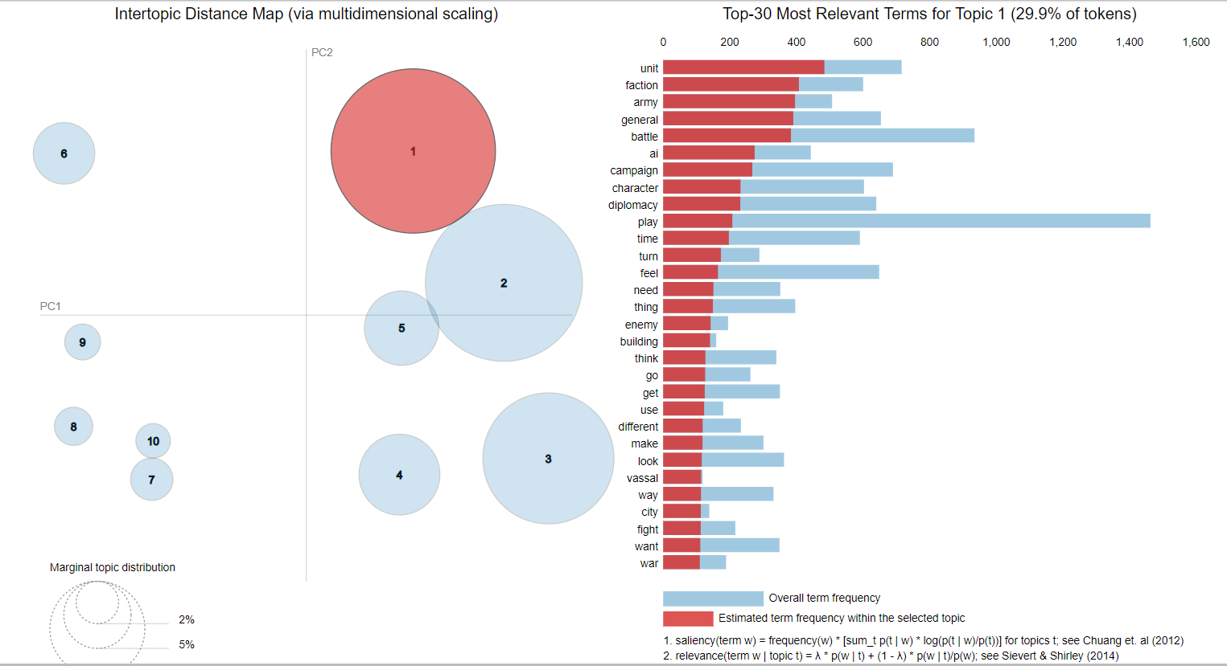
3. Topic Modelling
1st run output
Nouns, verbs, etc
Coherence score: 0.37
Topics not coherent

Slide 56
3. Topic Modelling
Revisited cleaning step
Removed everything except nouns and n-grams
Removed overly common terms with filter_extremes()
Removed some terms manually, which may be missed by filter_extremes() e.g. ‘total_war’

Slide 57
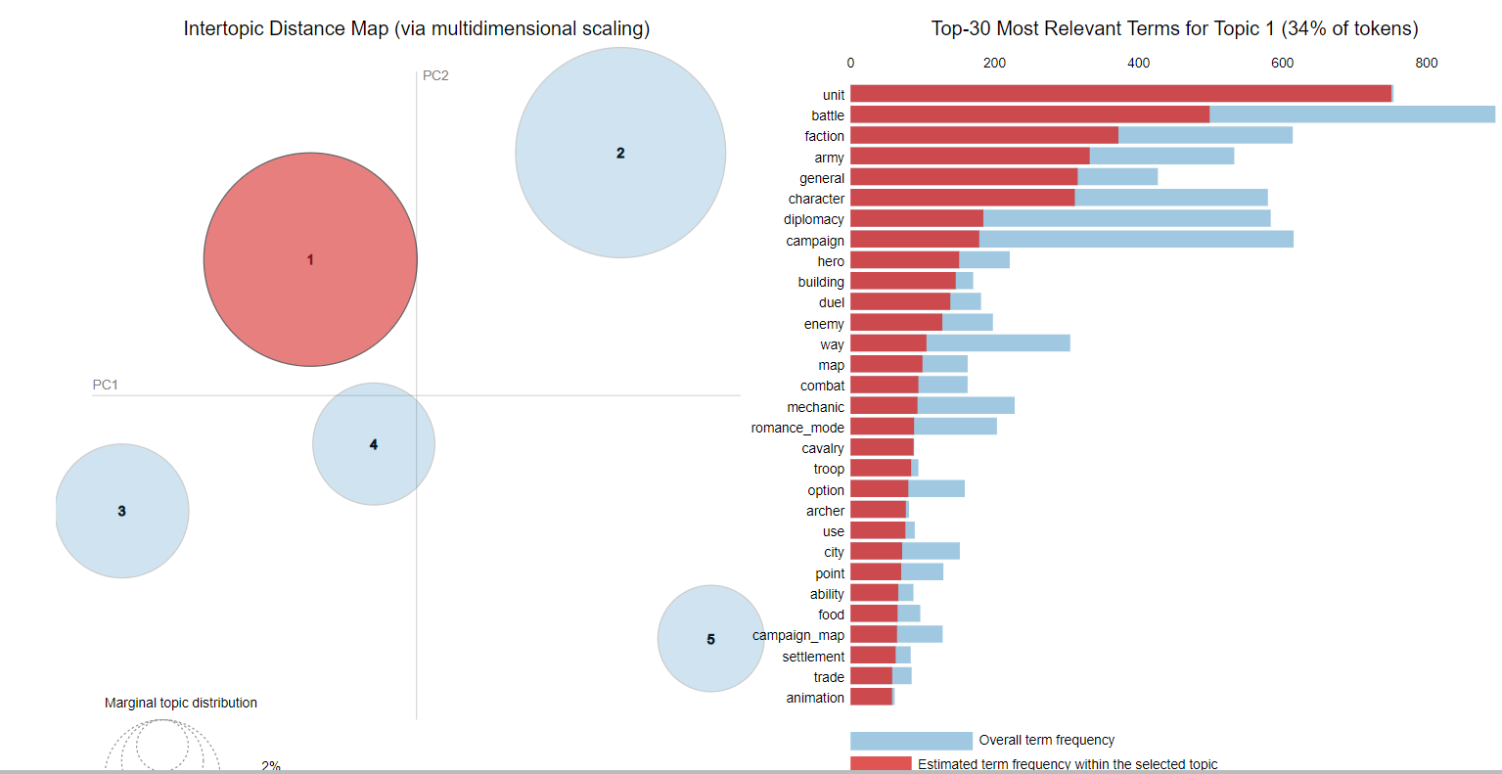
3. Topic Modelling
12th run output
Nouns & n-grams
Coherence score: 0.57!
Topics coherent

Slide 58
3. Topic Modelling
Iteration | Word Types | Keyword Count | Topics Specified | Topic Identification | Classification Accuracy
1 | All types | Any number | 10 | Incoherent | NA
2 | Nouns Verbs Phrases | Any number | 5 | Incoherent | NA
3 | Nouns Phrases | Any number | 5 | Coherent Clear separation | ~85%
Final | Nouns Phrases | At least 2 | 5 | Coherent Clear separation | ~87%

Slide 59
3. Topic Modelling
Model validation
~85% accuracy achieved
Method
Sample 10% of dataset and manually check labels
Sample 1: Low token counts (<= 5 tokens)
Sample 2: All token counts
Find sweet spot to set cut-off for minimum token count
Minimise misclassification rate

Slide 60
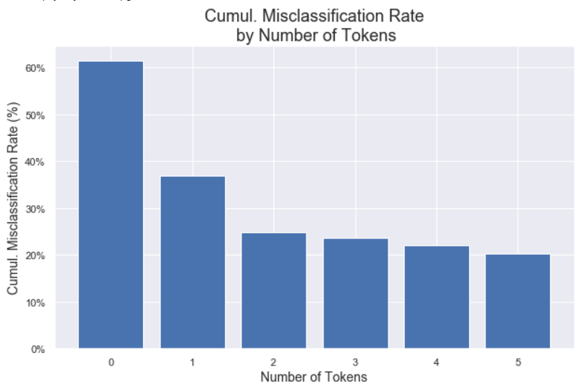
3. Topic Modelling
Low Token Sample Findings
Low tokens, high misclassification
LDA assigns most prevalent topic(s) when 0 tokens passed
Probability-based

Slide 61
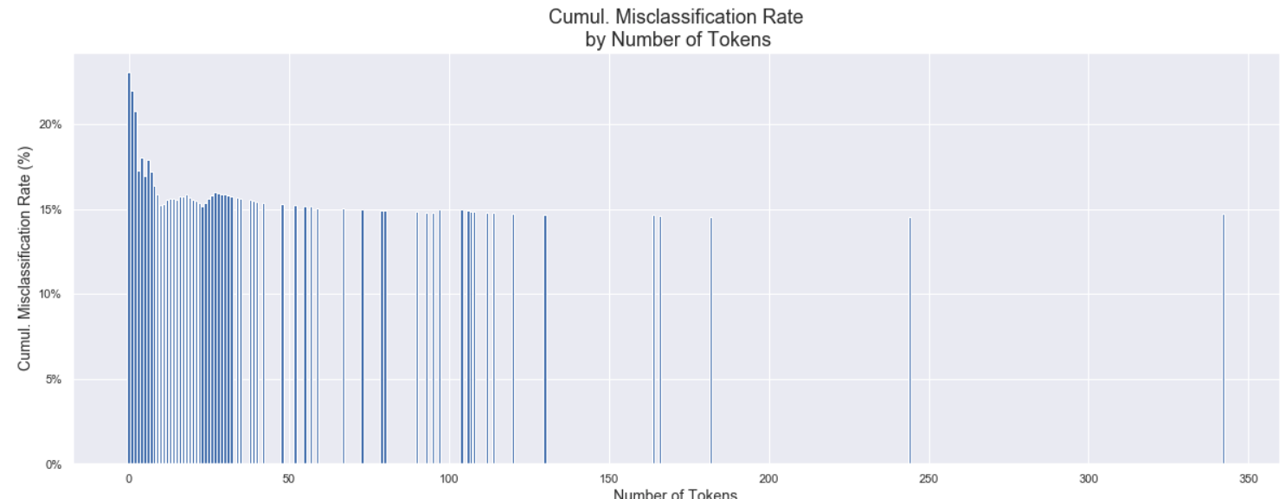
3. Topic Modelling
All tokens
Misclassification rate stabilises around 15% with higher token counts

Slide 62
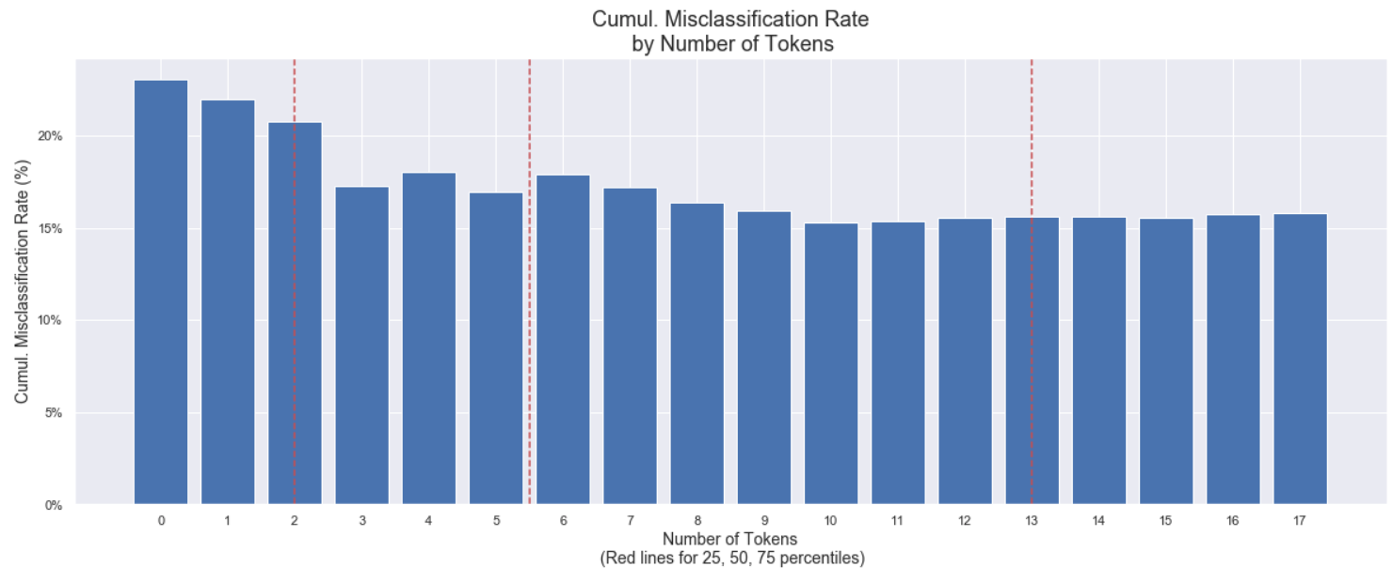
3. Topic Modelling
Red lines mark 25th, 50th, 75th percentiles
Less misclassification with 3 or more tokens, but unwilling to drop 2 tokens
Most reviews have 5 or fewer tokens – too much data to sacrifice

Slide 63
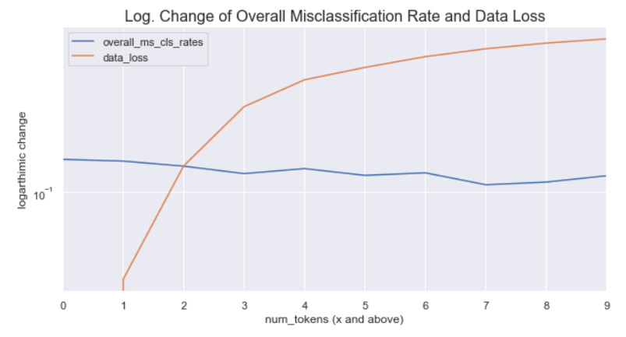
3. Topic Modelling
Drop 2 tokens ?
No. Bad trade-off!
Huge loss of data
Marginal reduction in misclassification rate
Best to keep reviews with at least 2 tokens

Slide 64
3. Topic Modelling – Topics Identified
Topics | Relevant Keywords
Content & Authenticity | three_kingdoms, series, fan, diplomacy, battle, love, best_total_war, campaign…
Characters | china, war, cao_cao, lu_bu, liu_bei, yuan_shao, army, character, man, emperor, warlord…
Strategic Gameplay | faction, army, diplomacy, vassal, war, player, people, way, city, problem, campaign…
Tactical Gameplay | unit, battle, faction, army, general, character, diplomacy, campaign, hero, building, duel…
UX/UI, Performance, Stability | campaign, hour, issue, battle, bug, crash, multiplayer, review, rome, fix, play, patch, work…

Slide 65

TopiC 1: Content & Authenticity
Keywords:
three_kingdoms, series, fan, diplomacy, battle, love, best_total_war, campaign…

Slide 66





Topic 2: Characters
Keywords:
china, war, cao_cao, lu_bu, liu_bei, yuan_shao, army, character, man, emperor, warlord…
Images: Total War Forums
© Creative Assembly

Slide 67

Topic 3: Strategic Gameplay
Image: StrategyGamer
Keywords:
faction, army, diplomacy, vassal, war, player, people, way, city, problem, campaign…

Slide 68
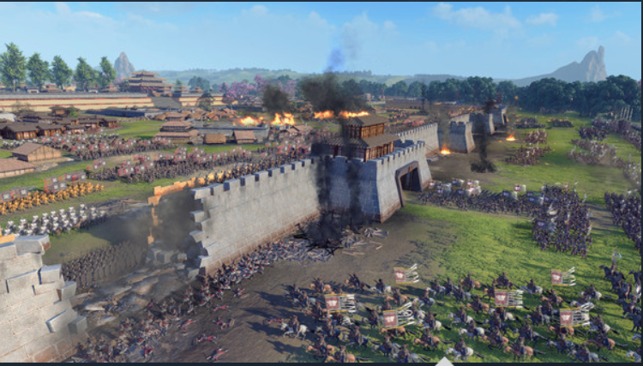
Topic 4: Tactical Gameplay
Image: Total War: Three Kingdoms on Steam
Keywords:
unit, battle, faction, army, general, character, diplomacy, campaign, hero, building, duel…

Slide 69
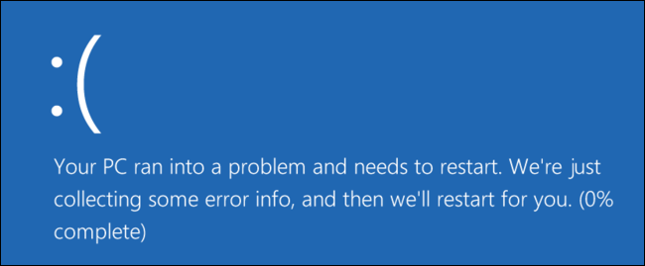
Topic 5: UX/UI, Performance, Stability
Image: HowToGeek
Keywords:
campaign, hour, issue, battle, bug, crash, multiplayer, review, rome, fix, play, patch, work…

Slide 70
4. Sentiment Analysis
Pass ORIGINAL text to VADER SentimentIntensityAnalyzer
Capitalisations and punctuation factor into calculations
Take compound score
Player-provided score not used
Most people have some level of mixed opinion
Steam does not allow players to put neutral scores

Slide 71
4. Sentiment Analysis
Known issues:
VADER tends to give a lot of neutral scores
VADER cannot handle sarcasm
VADER may read vulgarities used for emphasis as negative when they are in fact positive
Must assume most reviewers genuinely want to give feedback
Reasonable assumption. Paying players more likely to write useful reviews

Slide 72
4. Sentiment Analysis: Dealing with VADER
Keeping neutrals to a minimum:
Feed VADER longer text
Set tight boundary for neutral: -0.1 < x < 0.1
Aggregation issues
Reduce complexity by converting all decimals to integers
As long as outside neutral boundary, review is pos/neg
Snapshot essentially does not require specific scores

Slide 73
4. Sentiment Analysis
4 parsing & aggregation methods explored
By review
By sentences – SpaCy
By sentence topics within each review – SpaCy
By “paragraphs” within each review – Syntok
Scoring done with VADER for all methods

Slide 74
4. Sentiment Analysis
1. By Review
Rationale: Shape of data is consistent with training data
Method:
Identify dominant topic in each document
Assign score based on whole document sentiment
Problems:
Data wastage -- long reviews have more than 1 topic!
Biased scoring – score is for all text, not just dominant topic text

Slide 75
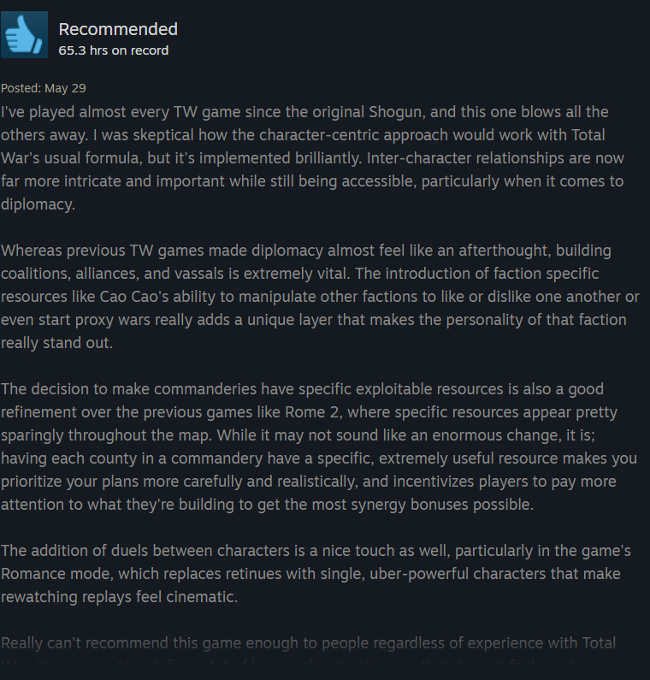
4. Sentiment Analysis
Anatomy of a Review
Multiple topics
Each topic has its own sentiment
Content & Authenticity
Strategic Gameplay
Tactical Gameplay

Slide 76

4. Sentiment Analysis – Scoring Reviews
Content & Authenticity
Strategic Gameplay
Topic | Sentiment
Content & Authenticity
Strategic Gameplay
Tactical Gameplay
Strategic Gameplay
Strategic Gameplay
Tactical Gameplay

Slide 77

4. Sentiment Analysis – Positive
Content & Authenticity
Topic | Sentiment
Content & Authenticity
Strategic Gameplay
Tactical Gameplay
Strategic Gameplay
Strategic Gameplay
Strategic Gameplay
Tactical Gameplay
It’s all about dominant sentiment!

Slide 78
4. Sentiment Analysis – Negative
Content & Authenticity
Topic | Sentiment
Content & Authenticity
Strategic Gameplay
Tactical Gameplay
Strategic Gameplay
Strategic Gameplay
Strategic Gameplay
Tactical Gameplay

Slide 79

4. Sentiment Analysis – Neutral
Strategic Gameplay
Topic | Sentiment
Strategic Gameplay
Tactical Gameplay
Strategic Gameplay
Strategic Gameplay
Strategic Gameplay
Tactical Gameplay

Slide 80
4. Sentiment Analysis
2. By Sentence (SpaCy)
Rationale: Can capture all topics in all documents
Method:
Tokenise sentences regardless of which review they came from
Score all sentences on their dominant topics
Problems:
SpaCy tokenisation issue. Classification accuracy too low, around 67%
No similarity to human way of gathering sentiment from reviews

Slide 81
4. Sentiment Analysis
3. By Sentence topics per Review (SpaCy)
Rationale: Aggregation logic similar to human logic
Method:
Tokenise sentences, assign review number, identify topics
Score all sentences on their dominant topics, aggregate by review, summarise
Problems:
SpaCy tokenisation issue remains
Results not accurate due to serious tokenisation issue

Slide 82
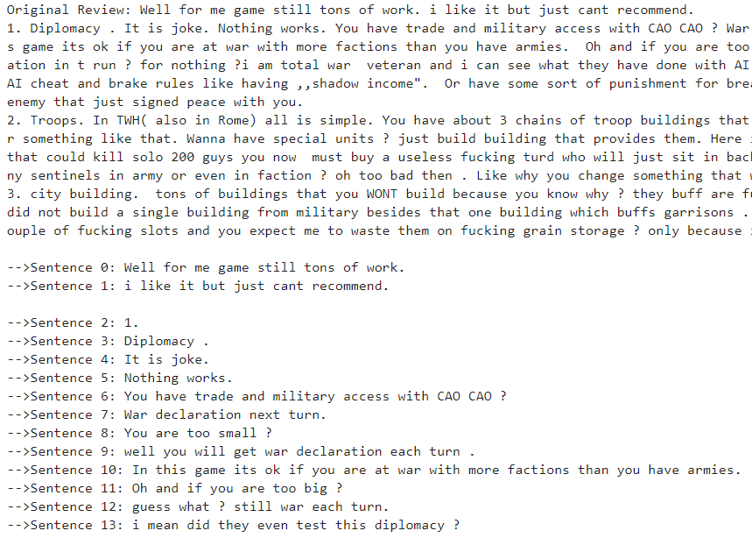
4. Sentiment Analysis
SpaCy tokenisation issues
Most sentences too short; will have 0 or 1 tokens.
High chance of data wastage & misclassification
“1.” should not be a sentence
SpaCy tokenised this review into 41 such sentences

Slide 83
4. Sentiment Analysis
4. By “paragraphs” in reviews (Syntok)
Rationale: Minimal data wastage, human-like aggregation logic
Method:
Tokenise “paragraphs”, assign review number, identify topics
Paragraphs actually result from accidental interaction between Syntok and expandContractions()
Score all “paragraphs” on their dominant topics, aggregate by review, summarise

Slide 84
4. Sentiment Analysis – Method 4 advantages (1)
Sweet spot between all methods
Minimised data wastage
Long reviews split into paragraphs and coherent sentences
Short reviews remain the same or tokenised into coherent sentences
Caveat: Working, but not perfect. Needs tweaking
Results more accurate
Topic model more accurate on paragraphs better than short sentences
More human aggregation logic

Slide 85
4. Sentiment Analysis – Aggregation
Topic Sentiment Score for Review
Topics | Sntmt
Content & Auth | Pos
Characters | Neutral
Strategic Gmply | Neg
Tactical Gmply | Pos
UX/UI, Perf, Stblty | Pos
Aggregate for whole dataset
Topics | Pos % | Neutral % | Neg %
Content & Authenticity | 73.8 | 10.1 | 16.1
Characters | 59.7 | 16.0 | 24.3
Strategic Gameplay | 55.1 | 11.9 | 33.0
Tactical Gameplay | 72.6 | 8.9 | 18.6
UX/UI, Performance, Stability | 63.4 | 12.6 | 24.0
Review 1
…
Topics | Sntmt
Characters | Pos
Strategic Gmply | Pos
Last Review

Slide 86
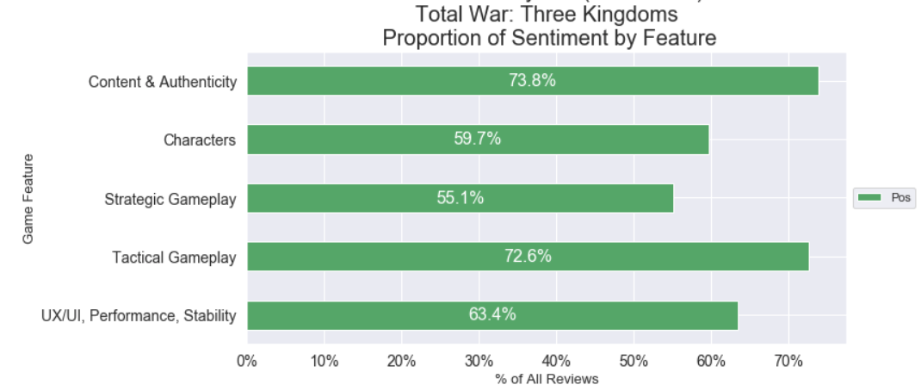
5. SteamVox Snapshots (1)

Slide 87
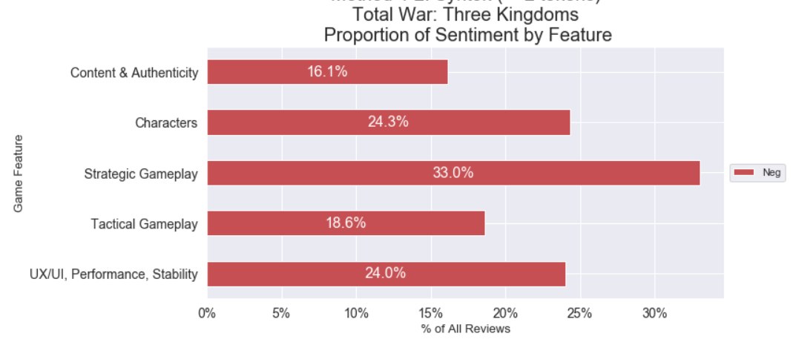
5. SteamVox Snapshots (2)

Slide 88
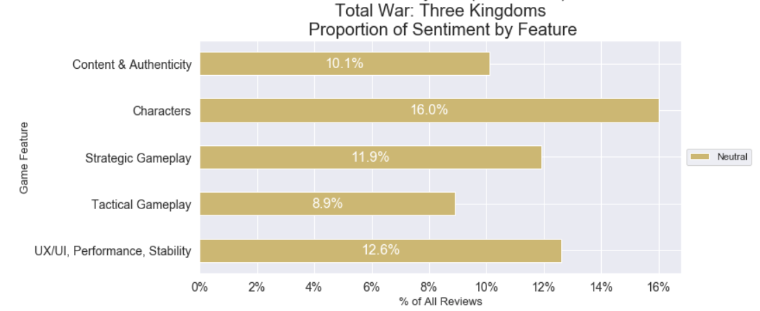
5. SteamVox Snapshots (3)

Slide 89
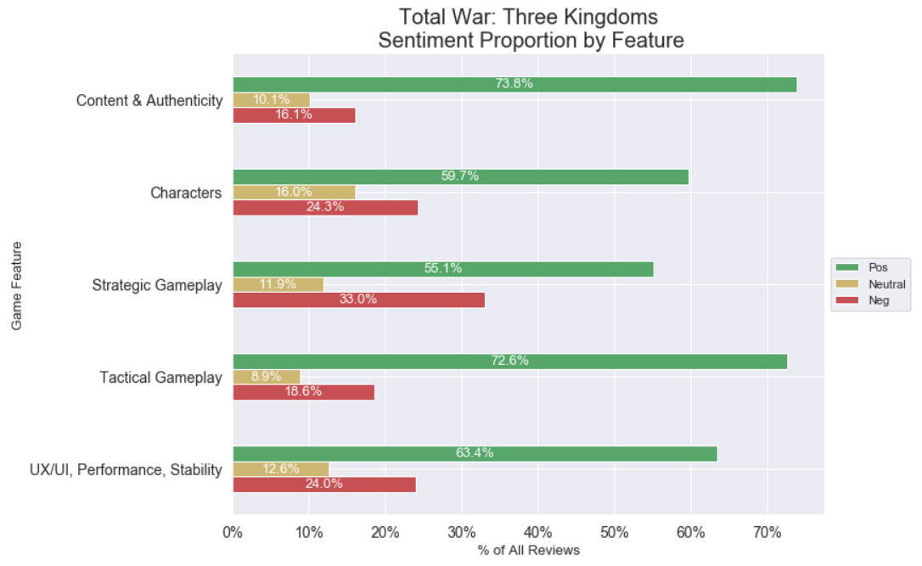
5. SteamVox Snapshots (4)

Slide 90
Syntok vs Spacy
SpaCy
General language processing tool
Has sentence tokeniser
Syntok
Specialised tool for parsing paragraphs and sentences
Has more coherent sentence tokeniser

Slide 91
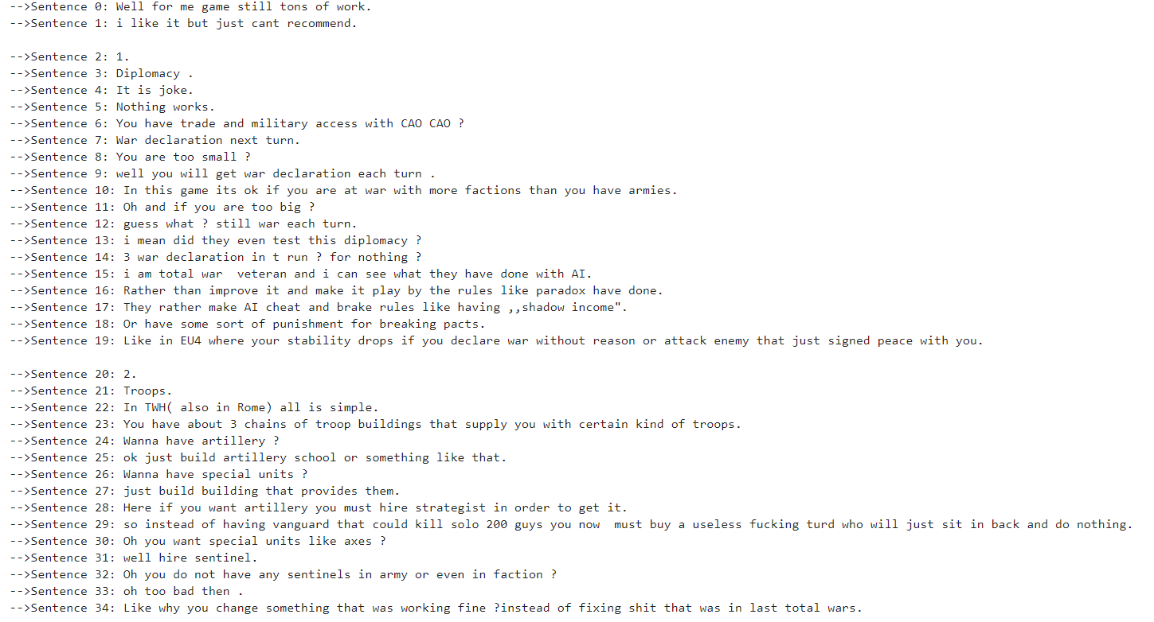
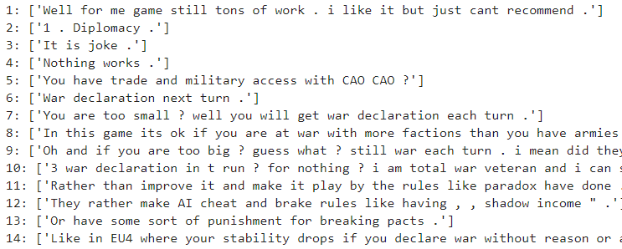
Syntok vs Spacy
SpaCy
Syntok
41 sentences
27 coherent sentences

Slide 92
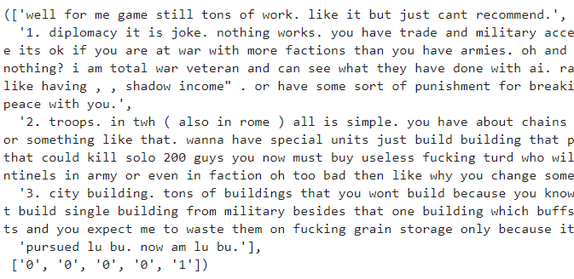
Syntok Paragraphing
Syntok & expandContractions() accidentally interact to create paragraphs
27 coherent sentences → 4 paragraphs!
It also happens to be how the player intended for it to be read.

Slide 93
SteamVox Roundup
SteamVox fulfils its intended purpose
Identifies coherent topics
Assigns accurate sentiment scores

Slide 94
Next Steps
Make SteamVox generally applicable across most games on Steam
Train SteamVox on larger Steam dataset
Tweak LDA Model further
Explore paragraphing methodology
Much more room to improve

Slide 95
Thank You!
Notes:
e.g. Review 1 has 2 topics, Tactical Gameplay and Strategic Gameplay. One is positive and the other negative.
Essentially, for this review, the data we can get looks like this:
|Topic|Score|
|:----|----:|
|Tactical Gameplay|1|
|Strategic Gameplay| -1|
Going one level higher, the dataset generally looks like this:
|Review| Topic | Score |
|----:|----|----:|
|1|Tactical Gameplay|1|
|1|Strategic Gameplay|-1|
|2|Characters|1|
|2|Strategic Gameplay|1|
In human English...
For each review in the dataset, the model:
1. Identifies topics in a review
2. Scores topic based on the dominant sentiment out of all sentences
3.
This kind of scoring is more akin to how a human would read a review and score the sentiment for each topic in that review.

Slide 96
References
DoctorSnapshot by nuwapi @ https://github.com/nuwapi/DoctorSnapshot/tree/master/src
https://blog.insightdatascience.com/topic-modeling-and-sentiment-analysis-to-pinpoint-the-perfect-doctor-6a8fdd4a3904
steamreviews scraper by woctezuma @ https://github.com/woctezuma/download-steam-reviews
expandContradictions by nealrs @ https://gist.github.com/nealrs/96342d8231b75cf4bb82
syntok by fnl @ https://github.com/fnl/syntok
Guide to Topic Modelling with Gensim @ https://www.machinelearningplus.com/nlp/topic-modeling-gensim-python/
SpaCy documentation @ https://spacy.io/api/tokenizer

